Slide 1



Handbook
For Young entrepreneurs

Slide 2


The Handbook of Growth project represents a holistic resource, bringing together theories on entrepreneurs' self-concept and essential business initiation skills. By aligning with the framework for youth entrepreneurship, it offers a cohesive approach, serving as a unified entry point for aspiring entrepreneurs.
Enjoy!
Disclaimer:
This project is funded with the support of the European Commission.
The information and views set out in this document are those of the author(s) and do not necessarily reflect the official opinion of the European Commission. Neither the European Union institutions nor any person acting on their behalf may be held responsible for the use which may be made of the information contained therein.

Slide 3
Content
1. What is Entrepreneurship & Industry Trends?
2. Developing Entrepreneurial Skills
3. How to identify Business Ideas and Opportunities
4. Skills for Business Planning and Strategy
5. Marketing and Customer Engagement skills
6. Financial management and funding skills
7. Integration of technology and Digital Tools

Slide 4


Module 1: Entrepreneurship and Industry Trends

Slide 5

Welcome to the exciting world of entrepreneurship!
Whether you're a budding business enthusiast or already embarked on your entrepreneurial journey, this guide is designed to equip you with the knowledge and skills needed to thrive in the ever-evolving landscape of industry trends.

Slide 6
Chapter 1: Introduction to Entrepreneurship
Entrepreneurship refers to the process of designing, launching, and managing a new business or startup to make a profit.
Entrepreneurs are individuals who take on the risks and responsibilities associated with starting and operating a business, often to introduce innovative products, services, or business models to the market.
Entrepreneurship can take various forms, including small businesses, startups, social enterprises, and more. It plays a vital role in economic development by creating jobs, fostering innovation, and contributing to overall economic growth.

Slide 7

Key Aspects of Entrepreneurship
Innovation
Progress by creating or improving products, services, and business methods through technological advancements or innovative models.
Adaptability
Adaptation to changing business environments, and adjusting strategies to align with market trends and external factors.
Networking
Building and maintaining a network of connections provides valuable resources, support, and collaborative opportunities for entrepreneurs.
Risk-taking
Entrepreneurship involves calculated decisions in the face of uncertainty, investing time and resources with awareness of potential success or failure.

Slide 8
Key aspects of Entrepreneurship
Resource management Efficiently managing capital, human resources, and time is crucial for entrepreneurs to ensure sustainable business growth.
Vision
Successful entrepreneurs have a clear, forward-looking vision, setting goals and making strategic decisions to build sustainable and profitable businesses.
Persistence
Entrepreneurs overcome challenges with resilience and persistence, steadfastly pursuing their goals in the face of setbacks.

Slide 9

Chapter 2: Identifying Industry-Specific Opportunities
Market Analysis
A market analysis is a detailed assessment of your company's target market and the competitive landscape in a particular industry. This analysis allows you to predict the success you can expect when introducing your brand and its products to consumers in the market.

Slide 10

Market Analysis in 6 STEPS
Research your industry
Investigate the competitive landscape
Identify Market Gaps
Define your target market
Identify barriers to entry
Create a sales forecast

Slide 11

Importance of Trend Analysis
Regular trend analysis provides a competitive advantage by keeping businesses ahead of the curve. Understanding market dynamics helps in anticipating competitors' moves and preparing strategic responses.
Identifying technological advancements is essential for innovation and adapting to changing consumer preferences. Businesses that stay abreast of emerging technologies are better positioned to integrate them into their operations and offerings.

Slide 12
Components of Trend Analysis
1. Industry Trends
Monitor macro-level industry trends such as market growth, consolidation, or disruption. Understand how external factors like economic shifts or geopolitical events impact the industry.
2. Technological Advancements
Keep an eye on technological developments that can transform business processes or create entirely new markets. Assess the potential impact of technologies like artificial intelligence, blockchain, or 5G on your industry.

Slide 13
Components of Trend Analysis
3. Consumer Behavior
Analyze changes in consumer preferences and behaviors, including shifts in shopping habits, lifestyle choices, and values. Use data analytics to understand customer feedback and sentiment.
4. Regulatory Changes
Stay informed about regulatory developments that may affect your industry. Compliance is essential; understanding and adapting to regulatory changes can mitigate risks and foster a positive reputation.

Slide 14

Strategies for Trend Analysis
Continuous Monitoring
Implement systems for continuous monitoring of news, industry reports, and market research. Utilize tools and services that provide real-time updates on relevant trends.
Networking and Industry Events
Attend conferences, trade shows, and industry events to connect with peers and stay informed about the latest developments. Networking can provide valuable insights from different perspectives.
Data Analytics
Leverage data analytics tools to analyze customer data, market trends, and performance metrics. Data-driven insights can reveal patterns and correlations.
Cross-Functional Collaboration
Facilitate collaboration between departments to ensure a holistic understanding of trends. Encourage employees to share insights and observations from their areas of expertise.

Slide 15

Chapter 3: Staying Updated on Industry Trends
In the ever-changing business landscape, staying current with industry trends is essential for success. Staying updated and informed about industry trends and updates in digital marketing is crucial for success in this fast-paced field.

Slide 16

Importance of Industry Trends
Staying informed about industry trends is crucial for entrepreneurs.
It informs :
decision-making
provides a competitive advantage
enhances customer satisfaction
mitigates risks
identifies innovation opportunities
fosters adaptability
encourages networking and collaboration
ensures regulatory compliance
boosts investor confidence and
contributes to long-term business viability.
It's not just beneficial—it's a strategic imperative for success in a dynamic business environment.

Slide 17

How to stay updated on Industry Trends?
Follow Key Influencers
One of the easiest ways to stay updated on industry trends is to follow the people who are shaping them. These could be thought leaders, experts, practitioners, or even competitors who share their insights, opinions, and experiences on social media, blogs, podcasts, or newsletters. By following key influencers, you can learn from their perspectives, discover new ideas, and engage with them and their followers.

Slide 18

How to stay updated on Industry Trends?
2. Join Professional Networks
Another way to stay in touch with industry trends is to join professional networks and communities that are relevant to your field. These could be online platforms, forums, groups, or associations that offer opportunities to connect with other professionals, exchange information, ask questions, and access resources. By joining professional networks, you can expand your network, gain feedback, and participate in discussions and events.

Slide 19
How to stay updated on Industry Trends?
3. Attend Webinars & Events
A third way to stay updated on industry trends is to attend webinars and events that cover topics and issues that are important to your industry. These could be online or offline, free or paid, formal or informal, depending on your preferences and availability. By attending webinars and events, you can learn from experts, stay informed of the latest developments, and interact with other attendees.
4. Read Publications & Reports
A fourth way to stay updated on industry trends is to read publications and reports that provide in-depth analysis, data, and forecasts for your industry. These could be industry-specific magazines, journals, newsletters, blogs, or research papers that offer valuable information and insights. By reading publications and reports, you can deepen your knowledge, identify opportunities and challenges, and benchmark your performance.

Slide 20

How to stay updated on Industry Trends?
5. Experiments and Learn
A fifth way to stay updated on industry trends is to experiment and learn from your own experiences and those of your team, customers, and partners. This means trying out new tools, methods, products, or services that are relevant to your industry, collecting feedback, measuring results, and making improvements. By experimenting and learning, you can test your assumptions, validate your ideas, and innovate.

Slide 21

Lessons of Successful Entrepreneurs
If there is ONLY one lesson you can learn from
Jeff Bezos Start small, GROW big
Bill Gates Be Your Own Boss and Start Early
Mark Zuckerberg Don’t Chase Money
Steve Jobs Put a Dent in the Universe
Larry Ellison Have a Clear Vision

Slide 22

Case study of Jeff Bezos - Amazon
Jeff Bezos founded Amazon in 1994 with the vision of becoming the "Earth's biggest bookstore." Anticipating the internet's growth and e-commerce's potential, Bezos positioned Amazon at the forefront of online retail. He prioritized long-term investment over immediate profits, a strategy that initially puzzled many investors.
Bezos's obsessive focus on customer satisfaction drove Amazon's expansion into various sectors. Innovations like customer reviews, personalized recommendations, and a robust return policy were designed to build trust and loyalty, ensuring repeat engagement.
Known for embracing innovation and taking significant risks, Bezos invested heavily in new technologies and services such as Amazon Prime, AWS (Amazon Web Services), and the Kindle. These initiatives required substantial upfront investment but diversified Amazon's revenue and cemented its market dominance. By 2020, these strategic moves had established Amazon as a powerhouse in multiple industries, demonstrating the effectiveness of Bezos's visionary and customer-centric approach.

Slide 23

Case study of Bill Gates-Microsoft
Bill Gates co-founded Microsoft in 1975 with the mission to place a computer on every desk and in every home. His strategic vision and business acumen transformed Microsoft from a small startup into a global technology giant. Gates's foresight of the personal computer revolution and dedication to software development were crucial to the company's early success.
A key strategy was licensing Microsoft's operating system to multiple hardware manufacturers, allowing MS-DOS and later Windows to dominate the market. Gates's aggressive business tactics and strategic partnerships helped Microsoft establish and maintain its market leadership.
Gates also emphasized continuous innovation, leading to the development of essential software like Microsoft Office. His focus on product quality and strategic foresight ensured Microsoft remained at the cutting edge of technology, thriving and expanding its influence in the tech sector.

Slide 24

Case study of Mark Zuckerberg- Facebook
Mark Zuckerberg launched Facebook in 2004 from his Harvard dorm room to connect people and foster online social interactions. His vision of a connected world resonated widely, propelling Facebook to rapid growth and global dominance in social media.
Zuckerberg's focus on user experience and constant innovation, like the News Feed, kept Facebook engaging and adaptable. Strategic acquisitions, such as Instagram and WhatsApp, expanded Facebook's user base and integrated new technologies, keeping the platform competitive. Zuckerberg's balance of innovation and strategic growth established Facebook as a leading force in social media.

Slide 25

Case study of Steve Jobs-Apple
Steve Jobs co-founded Apple in 1976 with the vision of making technology accessible and intuitive for everyone. His focus on design and user experience set Apple apart in the tech industry, believing technology should be beautifully designed and easy to use. Jobs's return to Apple in 1997 was a turning point. He streamlined the product line and focused on key products like the iMac, iPod, iPhone, and iPad, revolutionizing their markets and establishing Apple as an innovation leader. His insistence on seamless hardware and software integration resulted in superior user experiences. Marketing was also central to Jobs's strategy. He created anticipation around product launches, with the "Think Different" campaign reinforcing Apple's identity as a pioneer of innovation. Jobs's visionary leadership transformed Apple into one of the world's most valuable and influential companies.

Slide 26

Module 2: Developing Entrepreneurial Skills

Slide 27

Section 1: Introduction to Entrepreneurial Skills
Definition and characteristics of entrepreneurship
Entrepreneurship refers to the process of identifying, creating, and pursuing opportunities to establish and grow a business venture. It involves the willingness to take risks, innovate, and invest resources in order to bring a new product, service, or business idea to the market. Entrepreneurs are individuals who demonstrate a high level of initiative, creativity, and a proactive approach to addressing challenges and capitalizing on opportunities.

Slide 28

Section 1: Introduction to Entrepreneurial Skills
What are Entrepreneurial Skills?
Entrepreneurial skills refer to a set of abilities and attributes that individuals need to successfully start, manage, and grow a business venture. These skills are crucial for navigating the challenges and uncertainties inherent in entrepreneurship.
Examples of Entrepreneurial Skills:
Business management skills
Branding, Marketing, and Networking Skills
Communication and listening
Critical thinking skills
Strategic thinking and planning skills
Time Management and Organizational Skills
Customer service skills

Slide 29
Section 1: Introduction to Entrepreneurial Skills
Importance of Entrepreneurship Skills
Entrepreneurship skills are essential in positioning entrepreneurs to identify opportunities, make effective decisions, turn their ideas into reality, overcome challenges, and properly allocate resources to achieve goals and succeed. The importance of entrepreneurship skills lies in:
Encouraging social change and improving lives
Creating employment opportunities for others
Driving economic growth and opening new markets and industries
Improving the quality of life with new ideas and building functional products or services
Providing opportunities for personal and professional growth, as well as financial rewards
Enhancing one’s capacity to work efficiently alone, as well as in collaboration
Reaching the desired goals and achieving excellent results

Slide 30
Section 1: Introduction to Entrepreneurial Skills
Importance of entrepreneurship in the economy
Entrepreneurship plays a crucial role in the economy, contributing to its growth, innovation, and overall development. The importance of entrepreneurship in the economy can be seen through various key aspects:
Job Creation:
  Entrepreneurs create new businesses, which, in turn, generate employment opportunities. Small and medium-sized enterprises (SMEs), often led by entrepreneurs, are significant contributors to job creation globally.
Innovation and Technological Advancement:
  Entrepreneurs are drivers of innovation. They introduce new ideas, products, and services, leading to technological advancements that can improve efficiency, productivity, and overall economic competitiveness.
Economic Growth:
  The establishment and growth of businesses contribute directly to economic expansion. Entrepreneurs foster economic development by investing capital, creating wealth, and stimulating economic activity.

Slide 31

Section 2: Top 10 Entrepreneurial Skills
1. Business Management Skills
For entrepreneurs to effectively plan, organize, direct, and control an organization's resources, they must possess business management skills. These skills can increase a company's credibility, boost productivity, control risks, put successful plans into action, foster a pleasant workplace culture, and expand its clientele.
Business management skills include:
Leadership
Strategic thinking
Budget management
Business acumen
Communication

Slide 32
Section 2: Top 10 Entrepreneurial Skills
2. Communication and Listening
Through speaking, writing, and other forms of expression, people with effective communication skills may convey their thoughts, ideas, and feelings in a clear and concise manner. The capacity to comprehend, retain, and react correctly to information is a function of listening skills. In order to establish and develop connections, settle problems, comprehend needs and viewpoints, and make well-informed decisions, effective communication and listening are crucial entrepreneurship abilities.
Communication and listening skills include:
Written communication
Non-verbal communication
Stress management
Active listening
Emotion control

Slide 33

Section 2: Top 10 Entrepreneurial Skills
3. Critical and Creative Thinking Skills
Strong critical and creative thinking skills are essential for entrepreneurs to build and expand their businesses. Critical thinking allows you to objectively analyze information using the evidence to make informed decisions and solve problems. Creative thinking provides a way to look at issues from various angles, consider alternative perspectives, and come up with original ideas.
Critical and creative thinking skills include:
Analysis
Brainstorming
Visualization
Evaluation
Research

Slide 34
Section 2: Top 10 Entrepreneurial Skills
4. Strategic Thinking and Planning Skills
Entrepreneurs are able to assess data, adapt, manage projects, solve issues, and make well-informed judgments when they possess strategic thinking and planning skills. These entrepreneurial skills are essential for assisting leaders in overcoming obstacles, ensuring effective resource allocation, and achieving objectives.
Strategic thinking and planning skills include:
Analysis
Implementation
Flexibility
Attention to detail
Assertiveness

Slide 35

Section 2: Top 10 Entrepreneurial Skills
5. Branding, Marketing, and Networking Skills
Proficiency in branding, marketing, and networking is vital in the current cutthroat business landscape to facilitate firm expansion and enhance prospects. Entrepreneurs can market and sell goods and services with these abilities. Marketing spreads the word about a product, service, or organization to the intended audience, whereas branding builds a distinctive and memorable picture of it. Through networking, people can interact with possible suppliers, partners, consumers, and coworkers and develop relationships.
Branding, marketing, and networking skills include:
Collaboration
Communication
Interpersonal skills
Creativity
Collaboration

Slide 36
Section 2: Top 10 Entrepreneurial Skills
6. Entrepreneurial Skills in the Workplace
The skills in the workplace refer to qualities that enable individuals to effectively create and manage their businesses, as well as drive innovation and growth within organizations.
Entrepreneurial skills in the workplace include:
Time management
Finance skills
Sales
Adaptability
Problem-solving

Slide 37

Section 2: Top 10 Entrepreneurial Skills
7. Teamwork and Leadership Skills
Teamwork and leadership are highly critical entrepreneurship skills that foster a positive and collaborative organizational culture, leading to increased employee satisfaction and improved performance. These qualities can enable leaders to effectively inspire, motivate, work in teams, and lead the company toward success.
Teamwork and leadership skills include:
Communication
Emotional intelligence
Empathy
Delegation
Conflict resolution

Slide 38
Section 2: Top 10 Entrepreneurial Skills
8. Time Management and Organizational Skills
Effective leaders should be able to assign and prioritize work, control their time and resources, and keep their workplace organized and productive. Possessing good time management and organizing skills can help you accomplish objectives, control stress, preserve a positive work-life balance, and enhance happiness and wellbeing.
Time management and organizational skills include:
Prioritizing
Goal setting
Multi-tasking
Decision making
Collaboration

Slide 39

Section 2: Top 10 Entrepreneurial Skills
9. Sales Skills
In order to effectively pitch their companies to prospective clients and investors, entrepreneurs need to possess strong sales skills. Gaining confidence in sales can help business owners close deals, present their ideas to potential investors, engage in productive negotiations, and forge strong bonds with stakeholders, clients, and investors.
Sales skills include:
Business acumen
Negotiation
Relationship-building
Data analysis
Social selling

Slide 40
Section 2: Top 10 Entrepreneurial Skills
10. Stress Management Skills
Leading a business can take a toll on an entrepreneur’s well-being. They need to know how to efficiently manage and cope with stress for themselves, their employees, and their business. Stress management skills allow leaders to maintain good physical and mental health, enhance personal and professional relationships, and improve the overall quality of life.
Stress management skills include:
Meditation
Positive thinking
Mindfulness
Sleep hygiene
Exercise

Slide 41
Section 3: Improvement of Entrepreneurial Skills
Improving entrepreneurial skills is an ongoing process that involves a combination of education, experience, and continuous self-development. Here are several strategies to enhance your entrepreneurial skills:
1. Refine your interpersonal skills
Be confident, friendly and approachable–consistently. Practice these things daily and they’ll become habitual. Of course, everyone has their “off” days. Yet, these interpersonal skills can help weather them.
2. Connect with other entrepreneurs
Twitter is a great place to start. As a real-time platform, it’s perfect for eyeballing what others are up to and discovering key people.
3. Join communities in your industry
There are platforms that you can join such as Sara Zailskas Walsh, UX Writer & Content Strategist at Google.

Slide 42
Section 3: Improvement of Entrepreneurial Skills
4. Make a book list
Anything you hear about through colleagues, Ted Talks, conversations, and conferences can help enhance your entrepreneurial skills as well as anything you read. Make a list. Then slowly work your way through reading–or listening to–them.
5. Practice resilience
Learn from things that don’t work.
6. Ringfence time to de-stress
7. Keep your learning active
The need for continuous learning is high as an entrepreneur. Look for courses in your field (think about your strengths and weaknesses to spot gaps).

Slide 43
Section 4: Entrepreneurial skills in the workplace
As you develop your entrepreneurial skill set, you can practice applying your skills in the workplace by:
Finding leadership opportunities such as managing specific projects or teams, and requesting feedback on your performance as team leader to help you improve these skills
Helping coworkers organize and manage their time by helping them develop strategies that keep them organized and on task
Learning new skills that can transfer to owning your own business-like financial analysis, budgeting or networking skills
Learning from your supervisors by observing the approaches they use to manage teams, make decisions and collaborate with other managers
There are all sorts of ways that you might practice applying and developing your entrepreneurial skills, and these tips can be a helpful place to start.

Slide 44
Module 3:Identifying Business Ideas and Opportunities

Slide 45

Section 1:
What is a viable business idea?
According to experts like Barringer and Ireland (2016), a ‘viable’ business idea is a fantastic business idea that has the potential to take the world, or at least a small part of it by storm! It's not just any idea; it's the kind that matches what people want right now, can make money, and has a doable game plan that makes sense.
Having a viable business plan is like having the secret sauce to success.
Along with a great business idea, we can also consider the role of innovation in business success

Slide 46
Section 1:
What is innovation?
Innovation is not just about making things a ‘bit better’; it's about taking your ideas to a whole new level of awesomeness. Imagine finding smarter, faster, or just better ways of doing things. That's the magic of innovation!
Whether it's creating something entirely new, like a game-changing gadget or app, or tackling challenges with creative flair, innovation is your partner in crime for making your viable business ideas truly extraordinary.

Slide 47

Section 2 Real-life inspiration:
Let’s look at some real-life examples of successful business ideas, that started as just a spark in someone’s mind and turned into something extraordinary.
UBER: Imagine transforming the way people get around by simply connecting drivers with passengers through an app
That’s exactly what UBER did, making transportation more convenient and efficient globally.
Let’s look at how UBER came to be:

Slide 48

Back in 2009, on the bustling streets of San Francisco, two friends, Garrett Camp and Travis Kalanick, faced a common urban woe – There were never any taxis around when you needed one!
Frustrated by the inefficiencies of traditional taxi services, they envisioned a solution that would redefine transportation as we know it. The idea was simple yet revolutionary – use technology to connect people who need a ride with drivers willing to provide one.
In March 2009, Garrett and Travis officially launched UberCab a service that allowed users to request a ride through a mobile app. Little did they know, they were about to revolutionise the entire transportation industry!
Of course, UBER faced its fair share of problems and challenges in the beginning, from regulatory hurdles to skeptics questioning the viability of the idea. However, their determination and innovative approach to problem-solving led them to overcome these obstacles.

Slide 49
What started as a small startup in San Francisco quickly expanded its reach. The idea of ride-sharing caught on like wildfire, and Uber became a global phenomenon. It wasn’t just a ride-hailing service, it was a movement that transformed the way people thought about transportation.
As Uber continued to grow, it didn’t stop at just providing rides. The company introduced various other innovations such as Uber Eats, allowing users to have food delivered to their doorstep, and Uber Pool, a cost-effective ride-sharing option.
The Uber story is a remarkable journey from a simple idea born out of frustration to a global giant that redefined an entire industry. It teaches aspiring entrepreneurs the importance of identifying problems, embracing innovation, and persisting through challenges to create something extraordinary.

Slide 50
Now let’s take some time for reflection:
Take some time to consider the following questions, you can discuss them with a friend or make some notes in your notebook:
What market needs or problems did Uber identify, and how did the company address them?
How can entrepreneurs identify similar gaps or challenges in their own communities or industries?
Reflect on how Uber's model transformed transportation globally. In what ways did it influence the way people think about getting from one place to another?
Can you think of other industries where a similar transformative impact could occur?
When you have finished compare your answers with the ones on the next slide.

Slide 51
1. What market needs or problems did Uber identify, and how did the company address them?
Uber identified the need for a more convenient and efficient transportation option. Traditional taxi services were often unreliable and faced challenges in meeting demand. Uber addressed these issues by introducing a technology-driven platform that allowed users to request rides through a mobile app, providing a reliable and on-demand solution.
2. How can entrepreneurs identify similar gaps or challenges in their own communities or industries?
Entrepreneurs can identify gaps or challenges by actively observing and engaging with their communities or industries. Conducting surveys, listening to customer feedback, and staying informed about emerging trends are effective ways to uncover unmet needs. Additionally, entrepreneurs can explore areas where existing solutions are inefficient or outdated.

Slide 52
3. Reflect on how Uber's model transformed transportation globally. In what ways did it influence the way people think about getting from one place to another?
Uber transformed transportation by introducing the concept of ride-sharing, making it more accessible, convenient, and often more cost-effective than traditional taxi services. It shifted the mindset of people from viewing transportation as a standardized service to a personalized and on-demand experience. Users started to see transportation as a service that could be easily accessible with just a few taps on their smartphones.
4. Can you think of other industries where a similar transformative impact could occur?
Industries such as healthcare, education, and food delivery could undergo a transformative impact similar to what Uber brought to transportation. Any industry with inefficiencies, gaps, or outdated practices is ripe for transformative innovation.

Slide 53

Now let’s explore another idea that redefined established norms. Spotify.
Spotify was born in Sweden in 2006. Here 2 visionaries, Daniel Ek and Martin Lorentzon, recognised a need for a music service that was both accessible and legal. Fuelled by the desire to transform the way people experience music, they went on a journey that would redefine the entire music industry
The idea was to create a platform that grants users instant access to an extensive library of music without the need for physical copies. In a world dominated by piracy and rigid music distribution models, Spotify aimed to provide a legal and user-friendly alternative.

Slide 54
Now let’s explore another idea that redefined established norms. Spotify.
In October 2008, Spotify officially launched to the public, forever changing the way people consumed music. The platform introduced a freemium model, allowing users to enjoy a free, ad-supported version or upgrade to a premium subscription for an ad-free experience with additional perks.
Spotify didn't stop at just streaming music. The introduction of personalised playlists, driven by powerful algorithms, tailored the listening experience for each user. As the platform evolved, Spotify ventured into the world of podcasts, collaborating with creators to become a major player in the booming podcasting industry.

Slide 55
Spotify's impact wasn't confined to Sweden or Europe. The platform's global expansion rapidly turned it into a household name, challenging traditional music distribution models and setting the stage for the digital streaming era.
Spotify faced challenges along the way, including negotiations with record labels, criticisms from artists regarding royalty payments, and competition from other streaming services. However, its adaptability, commitment to user experience, and constant innovation allowed it to overcome these hurdles.
Today, Spotify stands as a symbol of innovation, reshaping the music industry by offering a seamless and personalized music streaming experience. It not only changed the way we access music but also influenced the broader shift towards digital and on-demand content consumption.
Entrepreneurs can draw valuable lessons from Spotify's journey – the importance of adapting to evolving user preferences, leveraging technology for personalisation, and challenging traditional industry norms. Spotify's story is a testament to the power of disruptive innovation in creating a global impact.

Slide 56
Now let’s take some time for reflection:
Take some time to consider the following questions, you can discuss them with a friend or make some notes in your notebook:
What market needs or problems did Spotify identify, and how did the company address them?
Reflect on how Spotify's model transformed music consumption globally. In what ways did it influence the way people think about accessing and experiencing music?
When you have finished compare your answers with the ones on the next slide.

Slide 57
1. What market needs or problems did Spotify identify, and how did the company address them?
Spotify identified the need for a legal and accessible music streaming service. The market faced challenges related to piracy, limited access to diverse music, and outdated distribution models. Spotify addressed these issues by introducing a platform that allowed users to stream a vast library of music instantly, legally, and with personalized features.
2. Reflect on how Spotify's model transformed music consumption globally. In what ways did it influence the way people think about accessing and experiencing music?
Spotify transformed music consumption by providing instant access to a vast library of songs. It shifted the mindset of people from owning physical copies or pirated versions to a more convenient and legal streaming experience. Spotify made music an on-demand, personalised journey, changing the perception of how people access and enjoy their favourite tunes

Slide 58
In the vibrant tech scene of Estonia in 2010, Kristo Käärmann, along with his co-founder Taavet Hinrikus, identified a significant problem faced by many - the high costs associated with international money transfers. Inspired by their personal experiences of working abroad and dealing with cross-border transactions, they set out to create a solution.
TransferWise was born out of the realization that traditional banks were imposing hefty fees and unfair exchange rates on people transferring money across borders. Kristo and Taavet envisioned a platform that would allow individuals and businesses to send money internationally at a fair and transparent rate, eliminating unnecessary fees.
The innovation behind TransferWise lay in its peer-to-peer currency exchange model. Instead of relying on traditional banking routes, the platform matched users looking to exchange currencies with others doing the opposite. This ingenious approach significantly reduced costs, making international money transfers more affordable for everyone.

Slide 59

TransferWise quickly gained traction and expanded globally, transforming the FinTech landscape. The platform's transparency, fair pricing, and ease of use resonated with individuals and businesses alike, challenging the dominance of traditional financial institutions in the international money transfer sector
Kristo Käärmann, as the co-founder and CEO of TransferWise, played a pivotal role in shaping the company's strategy and vision. His leadership, along with the innovative spirit of the team, propelled TransferWise to become one of the leading FinTech companies globally.
TransferWise, now known as Wise, has left a lasting legacy by demonstrating that financial services can be fair, transparent, and accessible to all. The platform's success encourages entrepreneurs, to venture into the FinTech space and drive positive change in the way financial services are delivered.

Slide 60
Now let’s take some time for reflection:
Take some time to consider the following questions, you can discuss them with a friend or make some notes in your notebook:
How did TransferWise's innovative peer-to-peer currency exchange model address a common challenge in international money transfers, and what lessons can entrepreneurs draw from this approach for solving problems in other industries?
In what ways did Kristo Käärmann's leadership contribute to the success and global impact of TransferWise, and what insights can aspiring entrepreneurs gain from his role in reshaping the FinTech landscape?
When you have finished compare your answers with the ones on the next slide.

Slide 61
1. How did TransferWise's innovative peer-to-peer currency exchange model address a common challenge in international money transfers, and what lessons can entrepreneurs draw from this approach for solving problems in other industries?
TransferWise's peer-to-peer currency exchange model addressed the challenge of high costs associated with international money transfers by cutting out traditional banking intermediaries. The platform allowed users to exchange currencies directly with each other, resulting in fair and transparent pricing. Entrepreneurs can draw the lesson that innovative, direct-to-consumer models can disrupt industries burdened by inefficiencies and high fees. By rethinking traditional processes, entrepreneurs can create solutions that provide value and better serve customer needs.
2. In what ways did Kristo Käärmann's leadership contribute to the success and global impact of TransferWise, and what insights can aspiring entrepreneurs gain from his role in reshaping the FinTech landscape?
Kristo Käärmann's leadership at TransferWise was characterised by strategic vision, resilience, and a commitment to fairness in financial services. His role in shaping the company's strategy and driving global expansion showcased the impact of bold leadership in the FinTech sector. Aspiring entrepreneurs can gain insights into the importance of strong leadership and the ability to navigate challenges.

Slide 62
Section 3: Systematic Approaches to Idea Generation and Evaluation.
What is Brainstorming and why does it matter?
Brainstorming is like a team activity where everybody gets together to come up with different ideas. The main idea is to let your creativity run wild and have an open chat about anything and everything. No judging allowed! During a brainstorming session, everyone can share their thoughts, suggestions, and ideas without worrying about someone saying, "Nah, that's not cool." It's all about letting our imaginations go wild and coming up with the best, most innovative stuff together.
Brainstorming is more than just throwing ideas into the air—it's about creating an atmosphere where innovation flourishes. Whether you're starting from scratch or refining an existing concept, effective brainstorming is the cornerstone of entrepreneurial success. It's your opportunity to explore the uncharted, challenge the status quo, and bring forth ideas that can redefine industries.

Slide 63
Top Tips for Brainstorming:
1. Create a Fun Environment:
Turn on some upbeat music, grab colourful markers, and make the space lively. Creating a fun and relaxed environment can boost creativity and make brainstorming sessions more enjoyable.
2. Think Big, Then Refine:
Encourage thinking without limitations at first. Let ideas flow without worrying too much about practicality. After the initial brainstorm, you can narrow down and refine the most promising concepts.
3. Doodle and Sketch:
Visualising ideas through doodles or simple sketches can help bring concepts to life. You don't need to be an artist; the goal is to get your ideas down on paper in a way that makes sense to you.
4. Involve Diverse Perspectives:
Get input from friends, family, or classmates with different interests and backgrounds. Diversity of thought can bring unique perspectives and enhance the richness of your ideas.
5. Use Technology Creatively:
Leverage technology tools that appeal to your generation. Virtual whiteboards, online collaboration platforms, and apps designed for creative thinking can add a tech-savvy twist to your brainstorming sessions.

Slide 64
6. Combine Passions:
Think about your hobbies, interests, and things you're passionate about. Combining your interests with potential business ideas can make your entrepreneurial journey more exciting and meaningful.
7. Set Small Challenges:
Start with small challenges or problems you notice in your daily life. How can you make something more efficient, fun, or sustainable? Solving everyday problems can lead to innovative business ideas.
8. Celebrate Crazy Ideas:
There are no bad ideas in brainstorming! Even the craziest concepts can spark something brilliant. Celebrate and build upon those wild, out-of-the-box thoughts.
9. Be Open to Collaboration:
Share your ideas with friends or classmates and encourage them to contribute. Collaboration can turn a solo brainstorming session into a dynamic idea exchange.
10. Stay Curious:
Keep your curiosity alive. Explore new trends, technologies, and industries. Being curious will help you stay open to fresh ideas and opportunities.

Slide 65
What is SWOT?
SWOT stands for Strengths, Weaknesses, Opportunities, and Threats. It can be useful for understanding your business idea inside out. Let's break down each component:
Strengths (S):
What makes your idea shine? Strengths are the superpowers your idea possesses. These could be unique features, skills, or resources that give your idea a competitive edge.
Weaknesses (W):
Every superhero has a weakness, right? Identify the aspects that might hold your idea back. It could be a lack of certain skills, limited resources, or potential challenges that need addressing.
Opportunities (O):
Look out for the exciting possibilities waiting to be explored. Opportunities are external factors in the world around you that your idea can leverage for success. Is there a growing market? Emerging trends? New technologies?
Threats (T):
Just like villains in a story, threats are external factors that could harm your idea. It might be competition, changing market trends, or any challenges that pose a risk.

Slide 66

How to Conduct a SWOT Analysis:
Strengths:
List down all the positive aspects of your idea.
What unique skills or knowledge do you bring to the table?
What features make your idea stand out?
Weaknesses:
Be honest about the challenges your idea might face.
Are there skills you need to develop?
What limitations does your idea have?
Opportunities:
Explore the external factors that could benefit your idea.
Are there trends or markets on the rise?
How can you capitalize on external opportunities?
Threats:
Identify potential challenges and risks.
Who or what could pose a threat to your idea's success?
What challenges might arise in the market?

Slide 67
Now let’s look at:
Section 4: Identifying Gaps in the market.
When we want to identify gaps in the market, this is about perceiving needs and opportunities that others might have overlooked.
To do this, consider the following:
Pay attention to your surroundings, daily experiences, and consumer behaviours. Sometimes, the most valuable insights emerge from the ordinary.
Successful businesses often emerge from addressing consumer pain points. What challenges do people face in their daily lives? Where do existing products or services fall short? Analysing these pain points can reveal gaps waiting to be filled
Dive deep into comprehensive market research. Understand the current landscape of products or services in your industry. What is popular, and what seems to be lacking? Surveys, interviews, and data analysis can be powerful tools to uncover gaps.
Explore niche markets that might be underserved or overlooked by larger competitors. Niches can be rich sources of opportunities, providing a unique space for your business to thrive. Think about specific demographics, geographic regions, or specialised interests.

Slide 68
5. Keep a close eye on technological advancements. Technology can often create gaps in the market by opening up new possibilities. Consider how emerging technologies can be harnessed to introduce innovative products or services.
6. Stay ahead of industry trends and be aware of shifts in consumer preferences. What are people talking about, and where is the market headed? Identifying emerging trends can lead to opportunities that align with the evolving needs of consumers.
7.Analyse the strategies and offerings of your competitors. Where are they excelling, and where might they be falling short? Identifying gaps in the market relative to your competitors allows you to position your business strategically.
8. Consider the cultural and social dynamics of your target audience. How do cultural shifts influence their needs and desires? Understanding these dynamics can help you identify gaps that resonate with the values and preferences of your audience.
9.Anticipate future needs and trends. What might people need in the coming years? Thinking ahead and envisioning the future can position your business to be at the forefront of emerging market demands.
10.Listen to your potential customers. What are they saying about existing products or services? Customer feedback is a valuable source of information for identifying areas of improvement and innovation.

Slide 69


Module 4: Business Planning and Strategy

Slide 70

Objectives
  Understand the importance of business planning for startups and established ventures.
  Explore the components of a comprehensive business plan.
  Learn strategies for market analysis, segmentation, and competitive analysis.
  Discover methods for formulating effective differentiation strategies.
  Master the SWOT analysis technique and its application.
  Develop skills in risk assessment and management to navigate uncertainties effectively.

Slide 71



Introduction to Business Planning and Strategy
In today's fast-paced business world, knowing how to create good business plans and strategies is really important for making sure your business can keep growing. It's like having a roadmap to success. To do this well, you need to be good at looking at data, thinking ahead, and being ready to change course if needed.
Understanding things like how the market works, what customers want, and what your business is good at is key to making a good plan. But it's not just about planning – you also need to be able to put your plans into action and be flexible enough to adjust them as things change.
For small businesses, there are even more challenges to deal with, like not having enough money or facing ups and downs in the market. But by being smart about how you use your resources and being ready to adapt, you can make sure your business not only survives but thrives in a tough environment.

Slide 72
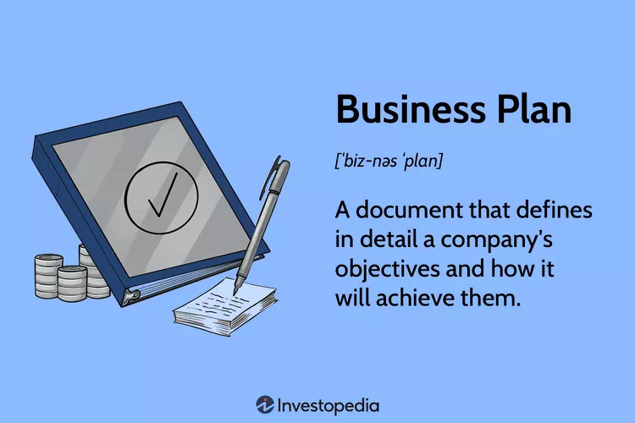
Definition of Business Planning
  Definition: The business plan serves as a comprehensive roadmap detailing a company's objectives and the strategies it will employ to achieve them. It encapsulates the essence of the business, outlining its mission, vision, and operational methods.
  Importance: Whether for startups or established enterprises, business plans are indispensable. Startups rely on them to secure financing and attract investors, while established businesses use them to maintain focus and alignment with their long-term goals.

Slide 73

Why Business Plans Matter
  Significance in Startups: Prior to launching operations, every new venture should meticulously draft a business plan. Financial institutions and venture capitalists often require it as a prerequisite for funding consideration, underscoring its pivotal role in securing vital resources.
  Viability and Planning: Research indicates that entrepreneurs who meticulously outline their business strategies through formal plans are 16% more likely to achieve viability compared to those who do not (Harvard Business Review, 2017). This underscores the criticality of planning in navigating the uncertainties inherent in entrepreneurial endeavors.
  Continuous Adaptation: A business plan is not static; rather, it should be subject to periodic review and revision to accommodate changing circumstances and evolving organizational objectives. This dynamic approach ensures alignment with market trends and enhances the company's responsiveness to emerging opportunities and challenges.

Slide 74

Understanding Strategic Vision
As we delve into the components of a business plan and strategies for market analysis, segmentation, competitive analysis, and risk assessment, it's crucial to emphasize the overarching importance of strategic vision.
A strategic vision serves as the guiding force behind these essential business processes. It shapes the goals, priorities, and decisions outlined in the business plan, providing a roadmap for navigating market complexities, identifying target segments, understanding competitors, and assessing risks. By aligning every aspect of business planning and analysis with a clear strategic vision, organizations can effectively chart their course towards sustainable growth and success.
Key Points:
Why It Matters:
  Guides strategy and decisions, enabling adaptation to market changes.
  Ensures alignment with mission, fostering sustained success and adaptability.
Benefits:
  Focuses efforts, aids goal achievement, and sets competitive edge.
  Establishes foundation for growth amidst dynamic market conditions.
Developing Your Vision:
  Define management roles, engage stakeholders, and analyze market position.
  Foster discussions for unified vision, format statement effectively, and gather feedback.
  Communicate vision widely and allow flexibility for adjustments.

Slide 75
Components of a Business Plan
Effective business plans consist of several essential components that outline various aspects of a company's goals and strategies.
Let's delve into the ten key components of a business plan:
  Executive Summary:
Provides an overview of the entire business plan, including the organization's mission, products, services, and the reason for starting the company.
  Business Description:
Offers a comprehensive overview of the business, its goals, products, services, target customer base, industry trends, major competitors, and the team's experience.
  Management and Organization Description:
Explores the management team's qualifications, responsibilities, human resource requirements, and the legal structure of the company.
  Products and Services Description:
Details the products and services offered, including manufacturing processes, durability, utility, and projected costs.
  Operating Plan:
Describes how the company plans to operate, including logistics, intellectual property, and personnel-related operations.

Slide 76
  Market Analysis and Segmentation:
Researches and identifies the primary target audience, their needs, demographics, and where they can be found, enabling strategic planning to meet their requirements effectively.
  Competitive Analysis:
Compares the company to its competitors, highlighting strengths, weaknesses, advantages, and distinctions, along with potential challenges in the marketplace.
  Differentiation Strategies:
Implements strategies to set your product or service apart from competitors, such as offering unique features, superior quality, or innovative solutions, thus creating a distinct value proposition in the market.
  Risk Assessment:
Identifies and analyzes potential risks to business activities, enabling proactive measures for mitigation and safeguarding continuity.
  Marketing and Sales Plan:
Outlines marketing and promotion strategies, pricing plans, sales strategies, unique selling propositions, and methods to reach the target audience.
  Financial Projection and Needs:
Explains revenue generation methods, funding sources, financial statements, analysis, and cash flow projections.

Slide 77
Market Analysis and Segmentation
What is Market Segmentation?
Market segmentation is the process of dividing a target market into manageable groups based on various factors such as demographics, needs, priorities, common interests, and other psychographic or behavioral criteria. This practice helps businesses better understand their audience and tailor their marketing strategies to effectively reach and engage with different segments of the market.
Benefits of Market Segmentation
Market segmentation offers significant advantages to companies that implement it effectively. A study by Bain & Company highlights that 81% of executives consider segmentation crucial for boosting profits, with organizations employing strong segmentation strategies enjoying a 10% higher profit over five years. Benefits include crafting stronger marketing messages tailored to specific customer groups, targeted digital advertising based on audience characteristics, and the development of effective marketing strategies attuned to target audience preferences. Additionally, market segmentation facilitates better response rates and lower acquisition costs, attracts the right customers, increases brand loyalty, and differentiates brands from competitors.

Slide 78
Market Analysis and Segmentation
Types of Market Segmentation
Market segmentation involves dividing a market into distinct groups based on various criteria such as demographics, geography, firmographics, behavior, and psychographics.
Demographic segmentation categorizes customers based on age, income, education, and other personal attributes, while geographic segmentation focuses on regional differences and preferences.
Firmographic segmentation targets organizations based on factors like company size and industry type. Behavioral segmentation examines consumer purchasing patterns and usage behaviors to tailor marketing strategies.
Psychographic segmentation delves into consumer lifestyles, values, and interests, relying on direct data from consumers themselves to understand their perspectives. Each segmentation method offers insights into customer preferences and behaviors, enabling businesses to develop targeted marketing approaches for different market segments.

Slide 79


Market Analysis and Segmentation
How to get started with Market Segmentation?
Here are the primary steps to segmentation:
  Define your market: Assess need, size, and market position.
  Segment your market: Choose criteria (demographic, psychographic, geographic, behavioral).
  Understand your market: Conduct research (surveys, focus groups).
  Create customer segments: Analyze research responses.
  Test marketing strategy: Implement and track effectiveness, adjust as needed.

Slide 80

Market Analysis and Segmentation
Market Segmentation Strategy
Market segmentation is a strategic approach that requires periodic review:
  Rapid changes, like the Covid-19 pandemic, demand adaptation to new customer needs.
  Yearly shifts occur due to external factors like natural disasters.
  Periodic updates are needed as market segments evolve throughout the year, influenced by holidays and seasonal trends.
When updating segmentation strategies, businesses should:
  Recognize changes and their driving forces.
  Proactively plan for long-term trends and potential issues.
  Understand the "why" behind market changes, utilizing advanced techniques for predictive and actionable segmentation.

Slide 81

Competitive Analysis
Understanding your competitors and conducting a thorough analysis are crucial for business success and investor interest.
A competitive analysis involves gathering information to identify competitors' strengths and weaknesses, informing strategies for gaining a competitive edge.
To conduct an analysis:
1. Identify competitors, both direct and indirect.
2. Analyze the market size, trends, and customer preferences.
3. Establish a framework for comparison.
4. Research competitors using various sources.
5. Assess strengths and weaknesses.
6. Identify opportunities and threats for your business.
Regularly review and update your analysis to stay ahead in the competitive landscape.

Slide 82

Competitive Analysis
To write your competitive analysis effectively, follow these steps:
1. Identify your audience: Tailor your analysis to investors, partners, or internal teams to address their specific interests and concerns.
2. Describe your competitive position: Assess your business against competitors based on the values you offer to your target market. Identify strengths, weaknesses, and areas for improvement.
3. Visualize your competitive position: Use tools like positioning maps or competitive matrices to illustrate your business's position relative to competitors.
By following these steps, you can effectively communicate your business's competitive landscape and positioning to stakeholders.

Slide 83
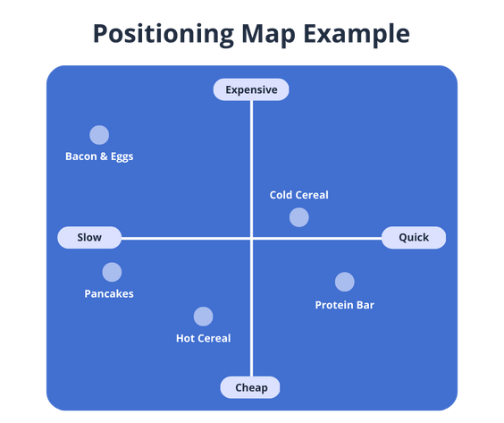
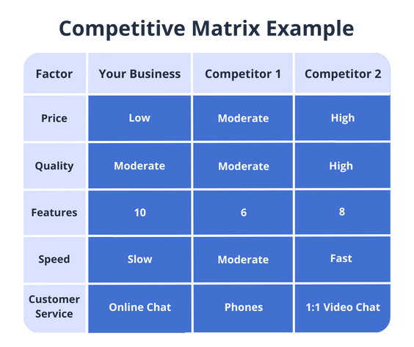
Competitive Analysis
A positioning map is a visual tool that compares two product or business benefits on a chart. It helps identify where your business and competitors stand in relation to each other based on these factors. A competitive matrix is a common feature in business plans, illustrating how various competitors compare based on factors outlined in the competitive framework.

Slide 84
Formulating Differentiation Strategies
What is a Differentiation Strategy?
Differentiation strategy involves making a product distinct from competitors to effectively engage a target audience. This can include emphasizing lower prices, specialized features, or better quality to gain brand recognition and market share. Targeting a niche market constitutes a focused differentiation strategy, while targeting a wide-ranging market constitutes a broad differentiation strategy. Crafting a unique value proposition (UVP) is often the initial step in developing a differentiation strategy.
Why Is Differentiation Strategy Important?
A differentiation strategy is vital for new businesses to stand out and succeed. Richard Branson highlights the necessity of offering something unique that larger competitors cannot easily replicate. For Virgin Atlantic, injecting humor and style into the brand helped it differentiate from competitors like British Airways. Without a solid differentiation strategy, new businesses may struggle to attract customers in competitive markets.

Slide 85


Formulating Differentiation Strategies
Consider these five differentiation strategies:
1. Features: Introduce unique design elements or functions.
2. Marketing tone: Develop a distinct branding and advertising style.
3. Pricing: Adjust pricing to attract customers.
4. Quality: Emphasize high-quality products and services.
5. Service: Provide excellent customer service.

Slide 86




SWOT Analysis
A strategic tool for evaluating internal and external factors influencing your business.
  What is SWOT analysis?
It's an acronym for Strengths, Weaknesses, Opportunities, and Threats.
  Strengths: Identify key areas where your company excels, showcasing its competitive advantages and resources.
  Weaknesses: Highlight internal challenges and limitations that may hinder your company's growth or performance.
  Opportunities: Explore potential avenues for expansion and development, aligning with emerging market trends or customer needs.
  Threats: Evaluate external factors that could pose risks or disrupt your
business operations, ensuring proactive risk management strategies.

Slide 87
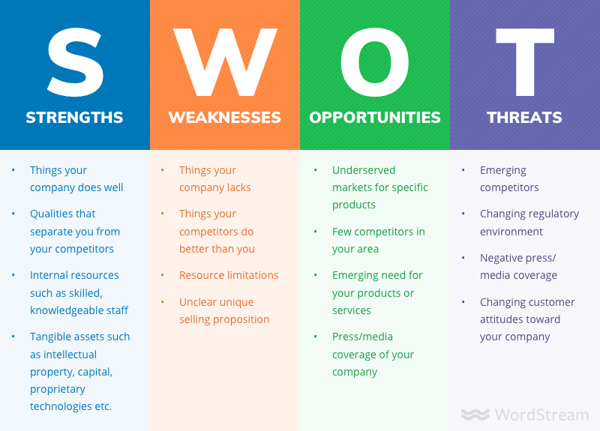
SWOT Analysis
How to Do a SWOT Analysis (With Examples & Free Template!)

Slide 88


Risk Assessment and Management
The risk management process involves five key steps:
1. Risk Identification: Identify potential risks that could affect the organization through brainstorming and trend analysis.
2. Risk Analysis: Assess the likelihood and impact of each risk, prioritizing them accordingly.
3. Risk Control: Implement measures to mitigate or eliminate identified risks, which may involve process changes or investments.
4. Risk Financing: Allocate funds to cover potential risks through insurance, reserve funds, or self-insurance.
5. Claims Management: Handle actual or potential claims resulting from risk events, including investigation, negotiation, and payment.

Slide 89
Identifying Risks
Financial Risk
Entrepreneurs are risk-takers, driven by a vision to fill industry gaps.
They often leave stable jobs to launch businesses, facing uncertainties like unstable income and limited personal time. Before starting, they must assess and minimize common risks.
Strategic Risk
Strategic risk arises when market or environmental changes render chosen strategies ineffective, impacting a company's ability to meet its benchmarks and key performance indicators (KPIs).
Technology Risk
Technology risk involves adapting to emerging technologies, which can be disruptive and require significant investments in new systems and processes, impacting financial performance.
Market Risk
Market risk encompasses various factors including economic fluctuations, market trends, and competitor actions, all of which can impact the demand and success of a product or service, necessitating thorough market analysis by entrepreneurs.

Slide 90
Identifying Risks
Competitive Risk
Entrepreneurs must assess competitive risk, which includes gauging market demand through competitor presence, understanding market saturation with larger competitors, and safeguarding innovations via patents to mitigate potential threats.
Reputational Risk
Reputational risk is critical for new businesses, as initial customer experiences can significantly impact brand perception, with social media amplifying feedback effects; effective management involves proactive communication, relationship-building, and consumer engagement strategies.
Environmental, Political, and Economic Risk
Entrepreneurs face uncontrollable risks like natural disasters, political instability, and economic downturns, which can hinder trade or affect market demand; high-risk sectors such as food service, retail, and consulting may struggle to attract investors due to their historical failure rates.
While entrepreneurs should anticipate making costly mistakes, thorough planning, sufficient funding, and flexibility enhance the likelihood of business success.

Slide 91

Practical Tools for Developing Business Plan and Strategies Online
For business planning and strategy development, there are a number of tools available online, both with free and premium options. Here are some of the tools you can use:
Monday.com: This is a project management tool, also allowing for business plan development with its extensions and various options, providing a long-term vision for your ideas. It provides templates with customization option to align perfectly with your needs and goals.
PlanGuru: This online tool comes forward with its financial and budgeting options for your business, allowing you to go into detail when you are planning and operating your business. It also has a library to guide you through the process, along with tips & tricks for your business ideas.
Enloop: Through its interactive design, and business planning score range,
Enloop allows users to easily design their business plans and provide
Information on financial aspects as well.

Slide 92
Conclusion
Throughout this module, we've explored the critical components of strategic business planning, from defining objectives to understanding market dynamics and competitive analysis.
Business planning serves as a vital roadmap, guiding companies towards their goals and ensuring adaptability in a dynamic market environment.
As we conclude, it's essential to recognize the significance of continuous adaptation and periodic review of business strategies to stay aligned with evolving market trends and organizational objectives.
In the next modules we will delve into crucial aspects of business management, including marketing strategies and effective financial management techniques.

Slide 93


Module 5: Marketing and Customer Engagement

Slide 94
Chapter 1: Community-Centric Marketing
In this module, we delve into strategies and best practices that revolve around the unique characteristics, values, and needs of the local community. As businesses strive to foster meaningful connections and drive success, understanding and engaging with the community at a profound level has never been more crucial.
Community-Centric Marketing goes beyond traditional approaches, requiring a deep appreciation of local demographics, cultural nuances, and the art of tailoring messages that truly resonate with the community. Through this exploration, we aim to equip you with the insights and tools necessary to develop marketing initiatives that not only capture attention but also build lasting relationships within the fabric of the local environment.
The concept of communities is defined as groups of individuals uniting around a shared interest. These communities evolve based on a collective purpose, linked in common values and trust. In essence, communities form a vital foundation for sustained and meaningful engagement.

Slide 95
Chapter 1: Community-Centric Marketing
Understanding local demographics
Understanding your client base demographics is crucial for business planning. This includes age, income, education, occupation, marital status, gender, and family size. It ensures that service messaging reaches those who will truly benefit.
This analysis provides insights into the community's purchasing capacity. Furthermore, it is important to identify existing businesses offering similar products or services and analyze their marketing approaches.
Initiate online research on platforms like Google and social media is sufficient to identify existing or potential communities aligned with your organization's offerings. Assess whether their interest is direct or indirect.

Slide 96
Chapter 1: Community-Centric Marketing
b. Cultural Nuances and Sensitivity
Delving into the traditions, values, and customs of the community is a fundamental step. The analysis here ensures that businesses comprehend the context in which their marketing messages will be received.
Ensure that the messaging aligns with the cultural values of the community, fostering a sense of respect and cultural appreciation. This could mean using language that resonates with the community, incorporating local references, or addressing specific challenges or aspirations unique to the area.
c. Technological Adoption and Digital Literacy
The level of accessibility to digital technologies directly influences the potential reach of marketing efforts. Digital literacy levels guides the development of user-friendly content and interfaces, while insights into preferences for digital communication channels shape customer engagement strategies.
Assess whether there is a prevalent willingness to make online purchases and the extent to which online transactions are integrated into daily life. This analysis informs decisions regarding the development of e-commerce initiatives.

Slide 97
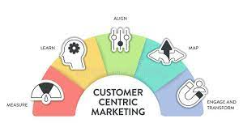
Chapter 1: Community-Centric Marketing
Conclusion of chapter 1
By tailoring marketing strategies to fit the characteristics of each community, businesses can build strong relationships and drive long-term success.Community-Centric Marketing consists a way for businesses to thrive by becoming an integral part of the communities they serve.

Slide 98
Chapter 2: Building and Sustaining Customer Relationships
A multifaceted approach is required in order to build and sustain customer relationships. In this analysis, we explore the fundamental strategies businesses employ to cultivate and maintain meaningful connections with their customers, paving the way for sustained success..
Engagement through Local Events and Initiatives
Local events and initiatives serve as powerful channels for Engagement. Actively participating in local initiatives showcases commitment. Engaging in local events and initiatives is beneficial and offer a unique opportunity to connect with a diverse audience and potentially encounter individuals genuinely interested in their field.
Actively engage in community endeavors to make your business the preferred choice when community members need services. Treat events as live commercials, seizing the opportunity to showcase your ongoing projects. Beyond promotion, use these occasions to forge meaningful partnerships and gather insights for future development.

Slide 99
Chapter 2: Building and Sustaining Customer Relationships
b. Feedback Mechanisms and Customer Satisfaction
Regular monitoring and updates are crucial for business success. By continually assessing and adapting your strategies, you can meet evolving customer needs and gauge your business performance effectively.
Relationship surveys are made to evaluate customer satisfaction and sentiment over an extended period. Conducted at regular intervals, such as quarterly or annually, these surveys allow you to track changes and trends in customer satisfaction over time. On the other hand, transaction surveys are focused on specific interactions, honing in on the immediate customer experience during a particular transaction, purchase, or interaction. Conducted shortly after the event, these surveys offer timely feedback that can be crucial for making quick improvements and adjustments.
Offer diverse channels for feedback, including surveys and online forms, ensures accessibility and broad participation.

Slide 100
Chapter 2: Building and Sustaining Customer Relationships
c. Long-Term Community Impact
Businesses gather feedback and adapt their community impact strategies over time. This involves assessing initiatives that prepare the community for challenges, emergencies, or economic fluctuations.
Examine the effectiveness of businesses' community engagement programs, assessing the depth of involvement, collaboration with local stakeholders, and the longevity of these programs in fostering positive change.
Evaluate the purposeful and strategic investments made by businesses in community initiatives, projects, or development programs. This includes job creation, support for local businesses, and initiatives fostering sustained economic well-being for community member.
Conclusion chapter 2
The insights gained from this chapter emphasize that successful customer relationship management goes beyond transactions; it's about building a lasting rapport, understanding evolving customer needs, and adapting strategies to ensure sustained satisfaction.

Slide 101

Chapter 3: The Art of Brand-making
The art of brand-making is a transformative force, where the first impressions can shape customer relationships. This extends beyond logos and visual elements, making together the essence of a company's identity, values, and promises.
Define a Brand Identity
This involves intentionally defining key elements of your brand, including its mission, values, and unique selling proposition. The mission provides purpose, values shape the brand's identity, and the unique selling proposition sets it apart from competitors.
Conduct thorough research to understand your target audience's in order to know how your brand can address their needs and connect with their aspirations.

Slide 102
Chapter 2: The Art of Brand-Making
b. Develop a Brand Name and Logo
Brand name and logo is crucial for cohesive brand representation. They should complement each other to create a unified and memorable brand identity. A visually appealing logo captures attention and creates a positive impressions. The aesthetics of the logo ( ex. the scheme, color and design) should convey a consistent message for the brand.
Analyze whether the combination is easily readable across various applications
The logo should be a symbol easily recognizable and evoke feelings that you want the target audience to associate with your brand.
Analyze whether it remains effective in black and white, as well as in digital and print formats.
Conclusions chapter 3
Through the brand making process, an initiative can gain strong recognition. Brand building is an ongoing process that demands regular evaluation to maintain a cohesive brand image.

Slide 103
Chapter 4: Sustainable Marketing
Sustainable marketing extends beyond product promotion to choices benefiting the planet and society. It revolves around designing and promoting goods with positive environmental and social impacts, essential for sustainable development.
Social responsibility
Socially responsible marketing involves ethical practices that go beyond profit-making, demonstrating a commitment to impactful actions. Aligning with social values builds consumer trust and loyalty. Ethical businesses are seen as trustworthy and socially conscious, fostering stronger connections with customers. As awareness of global issues grows, consumers prefer companies that share their values and contribute to societal well-being.
Educate your consumers about the social issues you are addressing and involve them in the process.
Regularly assess and measure the impact of your social responsibility initiatives. Use metrics and data to showcase the positive outcomes of your efforts.

Slide 104
Chapter 4: Sustainable Marketing
b. Environmental initiatives
Eco-friendly business practices:
Reduce, Reuse, Recycle: Promote waste reduction, material reuse, and recycling.
Carbon Footprint Reduction: Guide on measuring and cutting carbon footprints through energy efficiency and sustainable transportation.
Sustainable Supply Chain: Advocate for environmentally friendly materials, fair labor, and minimized transportation impact.
Eco-Friendly Packaging: Reduce waste, use biodegradable materials, and educate consumers on responsible disposal.
Innovation: Stay updated on new technologies for environmental impact reduction and foster a culture of adaptation.

Slide 105
Chapter 4: Sustainable Marketing
c. Consumer Education for Sustainable Choices
Businesses contribute to a more informed and conscious consumer base by focusing on consumer education for sustainable choices. This entails promoting sustainability through various initiatives:
Product Transparency: Provide clear environmental and social impact details through labels, certifications, and online resources.
Educational Campaigns: Raise awareness through content like blogs, videos, and infographics, emphasizing eco-friendly practices and sustainable living benefits.
Online Guides: Develop accessible resources on eco-friendly living, sustainable shopping, and reducing environmental impact.
Sustainable Rewards: Incentivize eco-conscious decisions with discounts, loyalty points, or exclusive benefits, reinforcing positive sustainable behaviors.

Slide 106
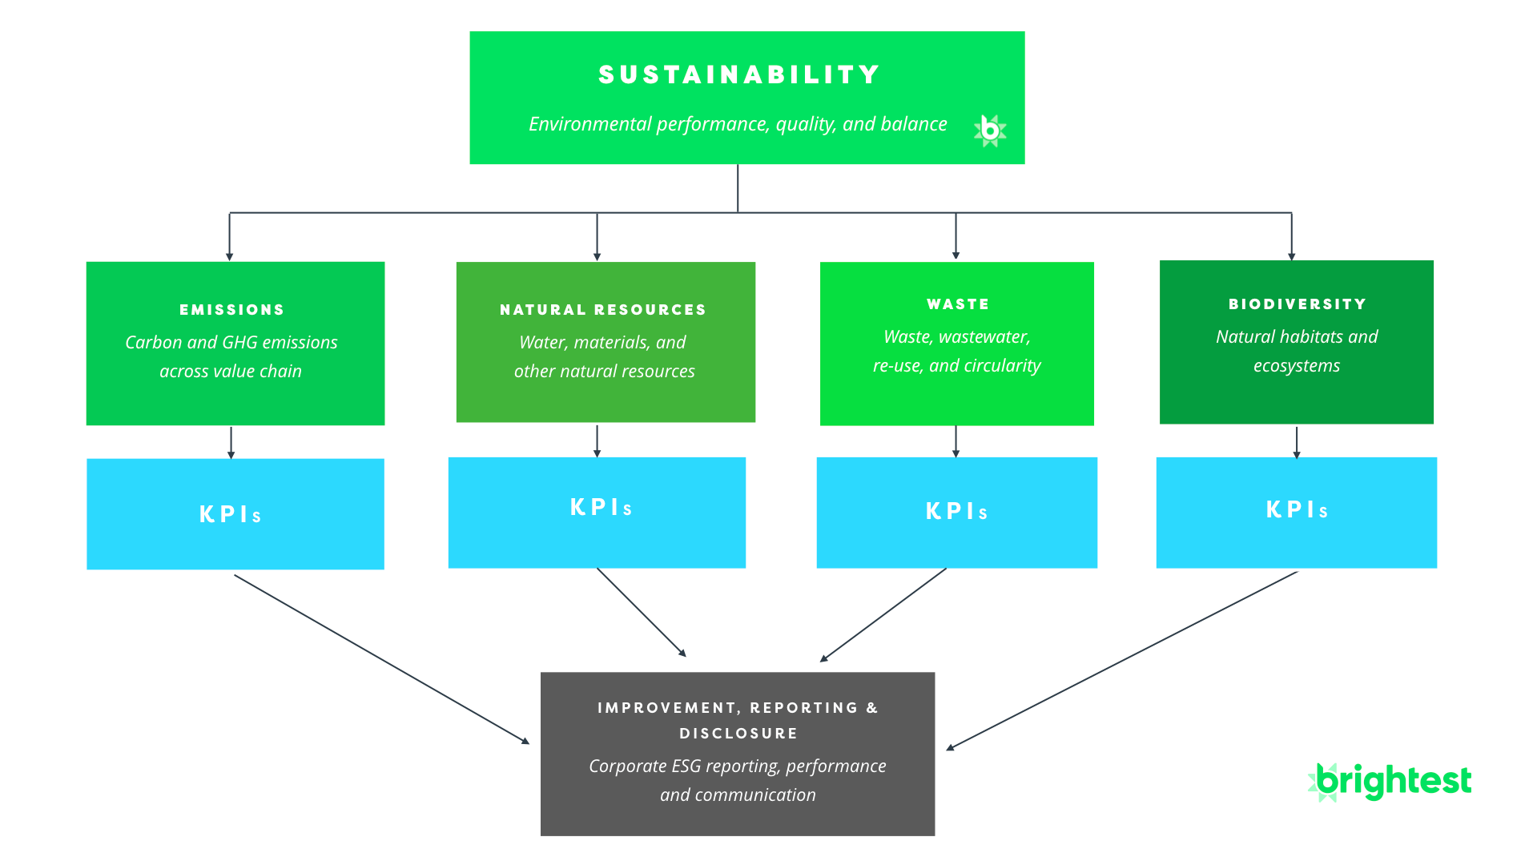
Chapter 4: Sustainable Marketing
d. Measuring Impact and Continuous Improvement
In the pursuit of sustainable marketing, businesses must embrace a commitment to measurable impact and perpetual enhancement. This involves establishing clear Key Performance Indicators (KPIs), quantifying both environmental and social outcomes, and regularly conducting audits and assessments.
Establish feedback mechanisms specifically for continuous improvement

Slide 107

Module 6: Financial Management and Funding

Slide 108
Introduction to Financial Management
Financial literacy is the ability to understand and effectively use financial skills, including personal financial management, budgeting, and investing. It forms the foundation of your relationship with money and is a lifelong learning journey. Starting early enhances your chances of success, as education is key. Financial literacy encompasses more than balancing a checkbook; it involves understanding how money works in business and life.
Here are some tips for managing your finances:
Bootstrapping: Use your own money or funds from friends and family when starting a business. This avoids borrowing and paying interest. Continue this practice as long as possible.
Tax Compliance: Entrepreneurs often face higher tax liabilities and may underestimate the importance of timely tax compliance. Seek professional help to stay on top of taxes and avoid end-of-year surprises.
Budgeting: Having a budget is crucial, especially for young entrepreneurs. Estimate the total monthly budget for different teams and activities to stay ahead and plan for contingencies.
Early Saving: Save money early to handle failures and emergencies. Savings can support your business and personal needs without added stress.
Record Keeping: Maintain organized financial records to comply with business regulations and avoid legal issues. Proper documentation is essential for your business's health and legality.

Slide 109
Budgeting and Forecasting
Budgeting and forecasting are crucial for business management, helping businesses plan finances, predict performance, and make informed decisions.
Steps to Create a Budget
Identify Income Sources: List all ways your business earns money, such as sales of products or services.
Determine Expenses: List all necessary expenses like rent, supplies, and wages.
Allocate Funds: Distribute money across various business needs, such as purchases and marketing.
Monitor Spending: Regularly compare actual spending to your budget and adjust as needed to avoid overspending.
Sales Forecasting
Estimating future sales helps in planning production, financial needs, and setting sales goals.
Look at Past Sales: Use historical data to predict future sales.
Monitor Market Trends: Observe economic trends to refine your sales forecasts.

Slide 110

Financial Planning
Preparing your business finances for the future involves
Managing Cash Flow: Ensuring sufficient funds for operations.
Investment Planning: Choosing investments to grow your business.
Risk Management: Identifying potential financial risks and preparing strategies to mitigate them.

Slide 111
Managing Cash Flow
Managing cash flow is about making sure your business always has enough money to keep running.
What is Cash Flow?
Cash flow is the money that comes in and goes out of your business. It's like your business's heartbeat, keeping everything running.
Why managing cash flow is important
It keeps your business alive: Good cash flow management makes sure your business has enough money to operate.
Avoid Financial Trouble: It helps you not run out of money unexpectedly.
Simple Strategies for Healthy Cash Flow
Keep track of money coming in and going out: Know when you get paid and when you need to pay bills.
Speed up incoming payments: Try to get customers to pay you faster.
Delay outgoing payments wisely: Pay your bills on time, but use the full payment period if needed.
Plan for big expenses: Save a bit of money regularly to prepare for big costs or slow business times.
Regularly review your cash flow: Check your cash flow often to avoid surprises.

Slide 112
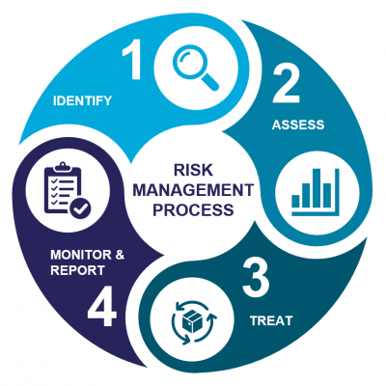
Financial risk management is crucial for any successful business, especially for young entrepreneurs. It involves identifying, analyzing, and mitigating risks that could impact the financial health of a business, protecting its capital and earnings to maintain stable cash flow and ensure long-term viability.
Key Stages of Financial Risk Management
Risk Identification: Recognize potential threats to the business’s finances.
Risk Assessment: Evaluate the likelihood and impact of these risks.
Risk Mitigation: Develop and implement strategies to minimize or avoid the risks.
Risk Monitoring: Continuously review and adjust risk management strategies.

Slide 113
Types of Financial Risks
Market Risk: Losses due to market fluctuations like interest rate or foreign exchange rate changes.
Credit Risk: Losses from a borrower's or counterparty's failure to meet obligations, impacting cash flow.
Liquidity Risk: Inability to meet short-term financial obligations, affecting operations.
Operational Risk: Losses from internal failures or inefficiencies, such as flawed processes or human error, significant in smaller or newer businesses.

Slide 114
Risk Identification
Risk identification is the process of recognizing potential threats that could negatively impact a business's finances. It is the first and most crucial step in the risk management process. Financial risks in business can arise from various sources, such as market fluctuations, credit issues, operational failures, and external events.
Steps in Risk Identification
Step 1: Gathering Information- Collecting data from various sources like financial statements, market reports, and industry news and understanding the business environment, including competitors, regulations, and economic conditions.
Step 2: Analyzing business activities- Reviewing internal processes, such as production, sales, and supply chain management, to identify areas of potential financial vulnerability.
Step 3: Engaging with stakeholders- Involving employees, customers, suppliers, and experts in discussions to gain diverse perspectives on potential risks.
Step 4: Identifying potential threats- Using the information gathered to pinpoint specific areas where the business might face financial risks.
Recognizing signs of potential threats, such as sudden changes in market demand or supplier instability.

Slide 115

Tools and Techniques for Risk Identification
SWOT Analysis (Strengths, Weaknesses, Opportunities, Threats): A strategic planning tool to identify internal and external factors affecting the business.
Checklists: Developing or using existing checklists tailored to the industry to ensure all potential risks are considered.
Brainstorming Sessions: Organizing team meetings to brainstorm potential risks in different areas of the business.

Slide 116
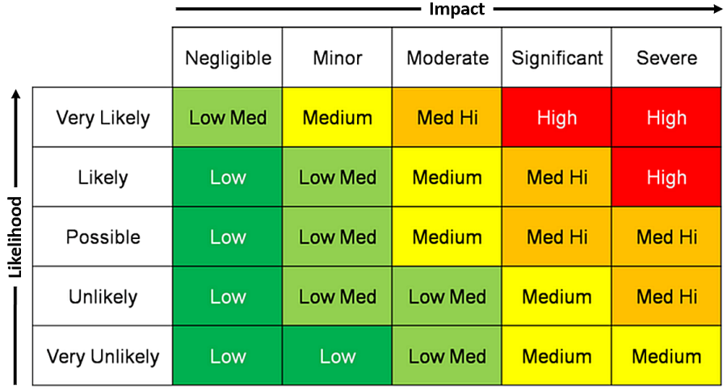
Risk assessment
Risk assessment is the process of determining the probability and consequences of risks, forming a crucial part of the risk management strategy.
Key Concepts in Risk Assessment
Risk Probability: The likelihood of a risk occurring.
Risk Impact: The potential consequences or effects of a risk if it occurs.
Risk Priority: Determining which risks need immediate attention based on their probability and impact.

Slide 117
Steps in Conducting a Risk Assessment
Identify Risks: Start with a comprehensive list of potential risks identified during the risk identification phase.
Evaluate Probability: Assess how likely each risk is to occur, considering factors such as historical data, industry trends, and expert opinions.
Assess Impact: Determine the potential severity of the impact for each risk. This could include financial loss, reputational damage, or operational disruption.
Prioritize Risks: Rank risks based on their probability and impact to focus on the most significant ones.
Tools and Techniques for Risk Assessment
Risk Matrix: A tool to visualize and prioritize risks based on their likelihood and impact.
Qualitative Analysis: Using descriptive terms to assess the magnitude and likelihood of risks.
Quantitative Analysis: Applying numerical values or statistics to measure and compare risks.

Slide 118
Risk monitoring
Risk monitoring is the continuous process of tracking and evaluating the levels of risk in a business environment. It involves regularly reviewing and updating risk management strategies to ensure they remain effective.
Implementing a Risk Monitoring Plan
Establishing monitoring processes: Set up procedures for regularly reviewing risks and the effectiveness of risk management strategies.
Selecting Key Risk Indicators (KRIs): Identify and use specific metrics that signal changes in risk exposure.
Integrating into business processes: Ensure that risk monitoring is a part of everyday business activities, not a separate or isolated task.
Regular Reporting: Develop a routine for reporting and discussing risk-related findings with relevant stakeholders.
Tools and Techniques for Effective Risk Monitoring
Risk Dashboards: Utilizing digital dashboards to display key risk indicators and trends.
Review Meetings: Regularly scheduled meetings to discuss risk status and management strategies.

Slide 119
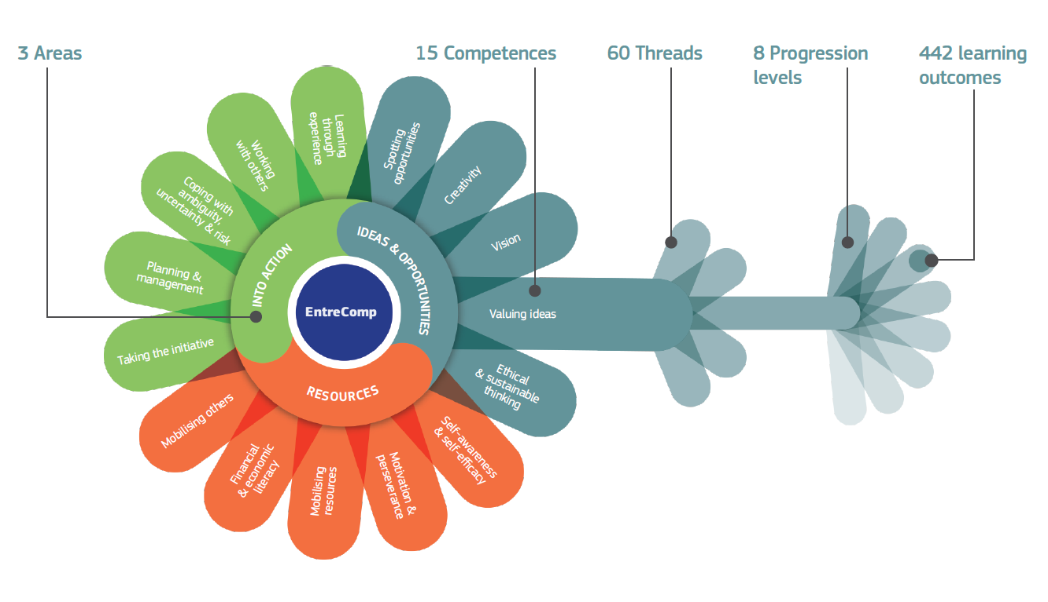
An intro into the Entrepreneurial competence
The European Entrepreneurship Competence Framework (EntreComp)
To understand more about the competencies related to the Entrepreneurship competence, in 2018, the EU created the European Entrepreneurship Competence Framework (EntreComp) as a reference to explain what is meant to have an entrepreneurial mindset.

Slide 120
Funding Options for Entrepreneurs
Intro
The EU recognized the importance of networking and the difficulties related to the access to markets and for this reason has created the COSME programme and the Enterprise Europe Network provides resources to all businesses wishing to expand into new markets. SMEs can approach the local partner in their region for advice and information. Over 600 partner organisations in 54 countries have the capacity to reach out to more than 2 million SMEs.
If you are interested in open up a new Business all over around the worlds the Enterprise network offer also local contact points in different EU and Non-EU nations: https://een.ec.europa.eu/local-contact-points
Another website offered by the EU support also the Women entrepreneurs and different Angels that can support you during your pattern: https://single-market-economy.ec.europa.eu/smes/supporting-entrepreneurship/women-entrepreneurs/support-tools-and-networks-women_en
The EU offers as well funds and economical support to start a business.

Slide 121
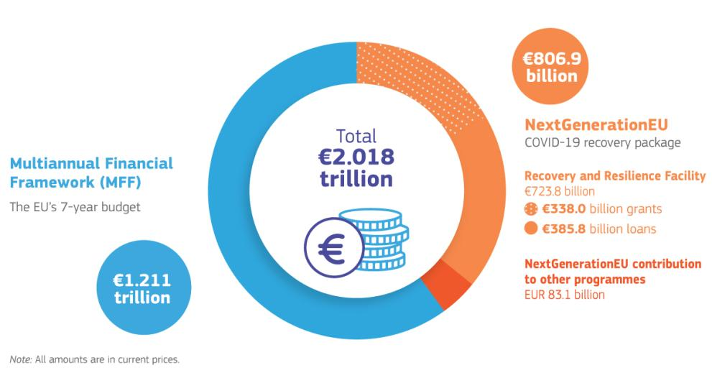
Funding Options for Entrepreneurs
Overview of funding sources within European Funds (2021 - 2027)
The EU’s long-term budget for 2021 to 2027
Temporary instrument to power the recovery

Slide 122
Funding Options for Entrepreneurs
2021 - 2027
The 2 most important funds offered by the European Funds for the period 2021 - 2027 are:
Single Market Programme
Erasmus for Young Entrepreneurs

Slide 123
Funding Options for Entrepreneurs
Overview of funding sources within European Funds (2021 - 2027)
Single Market Programme (SMP) by EISMEA (European Innovation Council and SMEs Executive Agency)
The Single Market Programme is the EU funding programme to finance activities supporting a well-functioning, sustainable internal market.
The €4.2 billion Single Market Programme will strengthen the governance of the EU single market. It will help to:
make the internal market work better with measures including improved market surveillance, problem-solving support to citizens and business, and enhanced competition policy
boost the competitiveness of businesses, in particular small and medium-sized enterprises (SMEs),
develop effective European standards and international financial and non-financial reporting and auditing standards
give even higher protection to consumers
maintain a high level of food safety
produce and disseminate high-quality statistics.

Slide 124

Beneficiaries:
Small and medium enterprises and Startups
Fields of action:
Agriculture, Energy and environment, Research, Innovation, Health, safety, transports, tourism, and governance.
Calls for proposals for actions supporting EU businesses under the Single Market Programme will be advertised on the website of the European Innovation Council and SMEs Executive Agency and published on the European Commission’s Funding and tender portal.

Slide 125
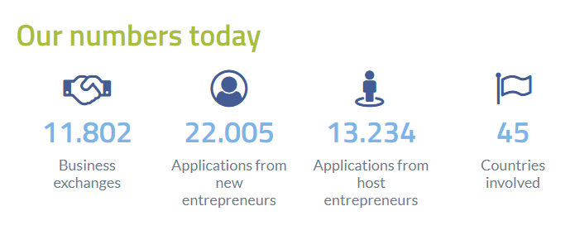
Funding Options for Entrepreneurs
Overview of funding sources within European Funds (2021 - 2027)
Erasmus for young entrepreneurs
Erasmus for Young Entrepreneurs is a cross-border exchange programme which gives new or aspiring entrepreneurs the chance to learn from experienced entrepreneurs running small businesses in other Participating Countries.
The exchange of experience takes place during a stay with the experienced entrepreneur, which helps the new entrepreneur acquire the skills needed to run a small firm. The host benefits from fresh perspectives on his/her business and gets the opportunities to cooperate with foreign partners or learn about new markets.
Who can participate?
New entrepreneurs, firmly planning to set up their own business or have already started one within the last three years
Host experienced entrepreneurs who own or manage a Small or Medium-Sized Enterprise in one of the Participating Countries.

Slide 126
Funding Options for Entrepreneurs
Overview of funding sources within European Funds (2021 - 2027)
Erasmus for young entrepreneurs
How to take part
New and experienced entrepreneurs who want to take part in the entrepreneurs’ exchange programme may apply via the programme website and choose their preferred local contact point in their respective countries of residence. Your application should include a CV, motivation letter and, in if you’re a new entrepreneur, a business plan. Once accepted, you can search the programme database for an entrepreneur to be matched with. We recommended that you read the registration guide carefully to have all required information at hand before starting the registration process.
EYE Global project
Thanks to extra financial resources, we have temporarily extended the programme to countries beyond Europe through EYE Global. Via EYE Global, new entrepreneurs from EU countries and the UK can also go on exchange with host entrepreneurs from Canada (British Columbia, Ontario, Quebec), Israel, Singapore, South Korea, Taiwan and the USA (NY State and California).

Slide 127
Funding Options for Entrepreneurs
Apart the fundings opportunities there are also other possibilities to begin a business:
Partners
Personal investors
Banks
Angel Investors, are often wealthy individuals who invest in the very early stage of new ventures
Venture capitalist, are institutional investors who belong to venture capital firms
Crowdfunding such us the Peer to peer lending.

Slide 128
Funding Options for Entrepreneurs
How to pitch to investors
Entrepreneurial pitch presentations are goal-oriented speeches designed to persuade investors to fund a business by appealing to both emotions and logic. Entrepreneurs must present a clear business idea, explaining who they are, the problem they aim to solve, their products or services, how they generate revenue and profits, why investment is necessary, and the amount of funding required. The main objective is to secure a funding opportunity by passing the initial screening stage in an investor’s decision-making process. A compelling pitch convinces investors to commit their money, accept financial risk, and invest their time.
Tips:
Keep it short and sweet (emotional part)
Present the problem that you are going to solve
Be clear and concise (You are in an elevator and you have to bloom and to catch the attention in 1 minute)
Practice your speech!!!

Slide 129

Module 7: Technology Integration and Digital Tools in Your Industry

Slide 130

Chapter 1: Incorporating ICT and E-Learning in the Industry
In today's fast-paced and technology-driven world, Information and Communication Technology (ICT) and e-learning have become indispensable tools in various industries. They offer numerous benefits, including enhanced efficiency, accessibility to a wealth of knowledge, and the ability to stay abreast of the latest industry trends and practices. ICT facilitates seamless communication and data management, while e-learning provides flexible and scalable educational opportunities.

Slide 131

Chapter 1: Incorporating ICT and E-Learning in the Industry
Examples of Companies Utilizing ICT and E-Learning
Google: Utilizes advanced ICT tools for data analytics and cloud computing, and
offers various e-learning resources through platforms like Google Digital Garage.
Siemens: Employs e-learning for employee training and development, utilizing virtual
simulations for technical skill enhancement.

Slide 132
Chapter 1: Incorporating ICT and E-Learning in the Industry
Why New Entrepreneurs Should Use ICT and E-Learning
For new entrepreneurs, leveraging ICT and e-learning is not just a convenience but a necessity. These tools provide startups with the means to compete in the global market by enabling efficient operations, reducing costs, and providing access to the latest business insights and training. E-learning, in particular, offers a cost-effective way to acquire new skills and knowledge, which is crucial for entrepreneurs who often have limited resources.
How ICT and E-Learning Aid Entrepreneurs
ICT tools like CRM systems, cloud computing, and social media platforms help entrepreneurs streamline their operations, reach wider audiences, and manage customer relationships more effectively. E-learning platforms offer entrepreneurs the flexibility to learn at their own pace and access a wide range of courses relevant to their industry, from digital marketing to financial management.

Slide 133

Chapter 1: Incorporating ICT and E-Learning in the Industry
Innovative Aspects of ICT and E-Learning
ICT and e-learning are at the forefront of innovation in education and business operations. They continuously evolve, incorporating the latest technologies such as AI, VR, and AR, to provide immersive and interactive learning experiences and efficient business solutions. This constant innovation ensures that entrepreneurs using these tools stay ahead of the curve.

Slide 134

Chapter 1: Incorporating ICT and E-Learning in the Industry
Cultivating an Entrepreneurial Mindset through ICT and E-Learning
By integrating ICT and e-learning, entrepreneurs can cultivate a mindset that is adaptive, creative, and forward-thinking. These tools encourage continuous learning, experimentation, and the adoption of new technologies, which are key components of an entrepreneurial mindset. They also foster a culture of innovation and constant improvement, essential for entrepreneurial success.

Slide 135
Chapter 1: Incorporating ICT and E-Learning in the Industry
Accelerating Business Development with ICT and E-Learning
ICT and e-learning can significantly accelerate the pace of business development. They provide entrepreneurs with the tools to quickly implement business ideas, test markets, gather customer feedback, and adapt strategies accordingly. E-learning, in particular, enables entrepreneurs to rapidly upskill, ensuring that their businesses can adapt and grow in ever-changing market conditions.

Slide 136

Chapter 2: Collaborating Within the Industry Online
In the modern business landscape, the ability to collaborate online is not just a convenience but a necessity, especially for entrepreneurs who often work with remote teams, clients, and partners across the globe. The advent of online collaboration tools has fundamentally changed the way businesses operate, breaking down geographical barriers and enabling real-time communication and project management. These tools have revolutionized traditional work methodologies, fostering more dynamic and efficient ways of working.

Slide 137
Chapter 2: Collaborating Within the Industry Online
The Advantages of Online Collaboration
Online collaboration brings a multitude of benefits to the table. Enhanced communication is one of the most significant advantages. Digital tools like Slack and Microsoft Teams have transformed workplace interactions, offering instant messaging and video conferencing features that make communication more immediate and dynamic compared to traditional email exchanges. This immediacy is crucial for quick decision-making and maintaining a steady flow of information.
Project management has also seen a transformation with the advent of online tools. Platforms like Trello and Asana have redefined task organization and team coordination, allowing for clear task setting, deadline management, and progress tracking. This ensures that all team members are aligned and informed about their responsibilities and project timelines.
Moreover, document sharing and collaboration have been greatly enhanced with cloud- based services like Google Drive and Dropbox. These platforms facilitate the sharing, editing, and real-time collaboration on documents, enhancing productivity and ensuring that all team members have access to the latest versions of documents, thereby reducing errors and improving workflow efficiency.

Slide 138

Chapter 2: Collaborating Within the Industry Online
Building a Digital Network
For entrepreneurs, building a digital network is crucial. Leveraging social media platforms, particularly LinkedIn, is invaluable for professional networking. These platforms enable entrepreneurs to connect with industry peers, potential clients, and mentors, expanding their professional network beyond geographical limitations.
Participating in online forums and industry-specific communities can also be highly beneficial. These platforms offer a wealth of knowledge, provide opportunities to seek advice, share experiences, and can be instrumental in building meaningful professional relationships.

Slide 139
Chapter 2: Collaborating Within the Industry Online
Virtual Teamwork and Management
Managing remote teams effectively is a skill that modern entrepreneurs need to master. Setting clear expectations is the first step in this process. This involves defining roles, responsibilities, and project goals to ensure that every team member understands their tasks and the broader objectives of the project.
Regular communication is key in a virtual environment. Scheduling regular meetings and check-ins helps in monitoring progress, addressing challenges promptly, and maintaining a sense of team cohesion. Additionally, building a strong team culture is essential, even in a virtual setting. Organizing virtual team-building activities and informal online meet-ups can help in creating a sense of belonging and camaraderie among team members.

Slide 140
Chapter 2: Collaborating Within the Industry Online
The Role of Online Collaboration in Fostering Entrepreneurship
Online collaboration tools play a key role in fostering an entrepreneurial ecosystem. They enable entrepreneurs to share knowledge and resources, collaborate on projects, and access global markets. This interconnectedness not only fosters innovation but also provides entrepreneurs with the tools and opportunities to scale their businesses and reach new heights.
Conclusion of chapter 2
Chapter 2 underscores the significance of online collaboration in today's business environment. For entrepreneurs, effectively utilizing these digital tools and strategies is essential for building a successful business. Online collaboration leads to enhanced productivity, a strong team culture, and access to a vast network of global resources and opportunities, all of which are crucial for entrepreneurial success.

Slide 141

Chapter 3: Utilizing Industry-Specific Digital Platforms and Tools
In the entrepreneurial journey, leveraging industry-specific Information and Communication Technology (ICT) solutions can be a game-changer. These digital tools are designed to address the unique challenges and needs of different industries, providing young entrepreneurs with the capabilities to enhance efficiency, foster innovation, and gain a competitive edge.

Slide 142
Chapter 3: Utilizing Industry-Specific Digital Platforms and Tools
Key ICT Solutions in Various Industries
For Tech Entrepreneurs:
GitHub: A vital tool for software development, offering version control and source code management. It facilitates collaboration on coding projects, making it easier for tech startups to manage their development process.
AWS (Amazon Web Services): Provides a broad set of cloud-based services, including computing power, storage options, and networking capabilities, essential for tech startups looking to scale their operations.
For Creative and Design Entrepreneurs:
Adobe Creative Cloud: Offers a suite of software for graphic design, video editing, web development, and photography, which is crucial for entrepreneurs in creative fields.
Canva: A user-friendly tool that allows entrepreneurs with limited design
expertise to create professional-quality graphics for marketing and branding.

Slide 143
Chapter 3: Utilizing Industry-Specific Digital Platforms and Tools
For E-commerce Entrepreneurs:
Shopify: An e-commerce platform that enables entrepreneurs to set up an online store with ease. It integrates various functionalities from inventory management to payment processing.
WooCommerce: A customizable e-commerce platform built on WordPress, allowing for the creation of an online store with a wide range of plugins and extensions.
For Hospitality Entrepreneurs:
Booking and Reservation Systems: Platforms like Booking.com and OpenTable streamline reservation management and enhance customer service.
Customer Relationship Management (CRM): Systems such as Salesforce and Zoho CRM are crucial for managing guest information and personalizing services.

Slide 144
Chapter 3: Utilizing Industry-Specific Digital Platforms and Tools
For Real Estate Entrepreneurs:
Virtual Tour Software: Tools like Matterport enable the creation of immersive 3D property
tours, enhancing the client's buying experience.
Property Management Tools: Software solutions like Buildium and AppFolio offer comprehensive property management capabilities.
For Manufacturing Entrepreneurs:
Supply Chain Management (SCM) Tools: Systems like SAP SCM and Oracle SCM Cloud optimize the entire supply chain process.
Computer-Aided Design (CAD) Software: Essential tools like AutoCAD and SolidWorks support product design and engineering.

Slide 145
Chapter 3: Utilizing Industry-Specific Digital Platforms and Tools
For Education Entrepreneurs:
Learning Management Systems (LMS): Platforms such as Canvas and Blackboard are vital for managing and delivering educational content online.
EdTech Tools: Interactive learning tools like Kahoot! and Quizlet engage students and enhance the learning experience.
For Environmental and Sustainability Entrepreneurs:
Energy Management Software: Tools like EnergyCAP and Entronix help in monitoring and managing energy usage efficiently.
Waste Management Apps: Platforms such as RecycleSmart and iRecycle offer innovative solutions for effective waste management and recycling.

Slide 146
Chapter 3: Utilizing Industry-Specific Digital Platforms and Tools
For Agriculture Entrepreneurs:
Farm Management Software: Tools like AgriWebb and FarmLogs assist in comprehensive farm management.
Precision Agriculture Technology: Advanced systems like Trimble Agriculture and John Deere Operations Center utilize data analytics for optimized farming practices.
For Entertainment Entrepreneurs:
Event Management Platforms: Tools such as Eventbrite and Cvent are essential for organizing and managing various events.
Streaming and Content Distribution: Platforms like Spotify for music and Vimeo for video content provide effective channels for distribution and monetization.

Slide 147

Chapter 3: Utilizing Industry-Specific Digital Platforms and Tools
The Transformative Impact of ICT Tools
The adoption of these ICT solutions transforms business operations, enabling entrepreneurs to automate routine tasks, streamline processes, and glean valuable insights from data analytics. This not only enhances productivity but also allows entrepreneurs to focus on strategic aspects of business growth. Moreover, the scalability of these tools ensures that as the business expands, the digital infrastructure grows alongside it, accommodating new challenges and opportunities.

Slide 148

Chapter 3: Utilizing Industry-Specific Digital Platforms and Tools
Fostering Innovation and Competitive Advantage
Beyond operational efficiency, these ICT tools are catalysts for innovation. They keep entrepreneurs at the forefront of technological advancements, enabling them to continually improve their offerings and adapt to changing market dynamics. By leveraging these tools, entrepreneurs can enhance customer experiences, develop innovative products and services, and maintain a competitive edge in their industries.

Slide 149
Resources
https://www.tutorialspoint.com/entrepreneurship_development/entrepreneurship_development_introduction.htm
https://squareup.com/us/en/the-bottom-line/operating-your-business/8-easy-ways-to-stay-on-top-of-industry-trends
https://www.coursera.org/articles/market-analysis
https://www.forbes.com/sites/forbescoachescouncil/2021/02/18/11-ways-to-stay-up-on-the-latest-industry-developments/
https://www.entrepreneur.com/growing-a-business/7-tips-to-stay-ahead-of-the-curve-in-your-industry/452436
https://www.quora.com/How-do-you-stay-informed-about-industry-trends-and-changes-in-the-market-1
https://medium.com/@priyanka.hashtag/how-to-stay-updated-and-informed-about-industry-trends-and-updates-in-digital-marketing-3573eec5a92a
https://www.shopify.com/blog/market-analysis
"The Skills You Need to Start a Great Business." Mind Tools Content Team.
Forbes (2021). Pandemic Fuels Global Growth Of Entrepreneurship And Startup Frenzy [online]
Jennifer Herrity (2023)“A Guide to Entrepreneurial Skills: Definition and Examples”
Catherine Cote (2020) “MUST-HAVE ENTREPRENEURIAL SKILLS FOR ASPIRING BUSINESS OWNERS”

Slide 150
https://www.investopedia.com/articles/personal-finance/111015/story-uber.asp
https://startuptalky.com/spotify_success_story/
https://newsroom.spotify.com/company-info/
https://www.forbes.com/sites/daviddawkins/2021/07/07/wise-founders-krmann-and-hinrikus-become-first-estonian-tech-billionaires-after-london-ipo/
https://www.investopedia.com/terms/s/swot.asp
https://www.forentrepreneurs.com/startup-ideation/
Berry, T. (2024, January 3). How to Write and conduct a Competitive Analysis - Bplans. Bplans: Free Business Planning Resources andTemplates https://www.bplans.com/business-planning/how-to-write/competition/
Collaborators, Q. (2023, August 30). Strategic Vision: Guide for Companies with Examples. QuestionPro. https://www.questionpro.com/blog/strategic-vision/
Creating a risk management plan for your business | SafetyCulture. (2023, December 13). SafetyCulture.https://safetyculture.com/topics/risk-management/risk-management-plan/
Differentiation Strategy: 5 ways to differentiate your product. (2022, August 4). Masterclass. Retrieved February 22, 2024, from https://www.masterclass.com/articles/differentiation-strategy

Slide 151
  Hayes, A. (2022, November 13). What risks does an entrepreneur face? Investopedia. https://www.investopedia.com/ask/answers/040615/what-risks-does-entrepreneur-face.asp
  Hayes, A. (2024, January 25). Business Plan: What It Is, What's Included, and How to Write One. Investopedia. https://www.investopedia.com/terms/b/business-plan.asp
  Market Segmentation: Definition, Types & Best Practices. (2023, September 25). Qualtrics. https://www.qualtrics.com/uk/experience-management/brand/market-segmentation/
  Shewan, D., & Shewan, D. (2024, January 25). How to do a SWOT Analysis (With examples & free template!). WordStream. https://www.wordstream.com/blog/ws/2017/12/20/swot-analysis
  Top 10 components of a business Plan - SmartAsset | SmartAsset. (2022, November 16). https://smartasset.com/small-business/top-components-of-a-business-plan
  Allen, Danica R, and American Society For Quality. Customer Satisfaction Research Management : A Comprehensive Guide to Integrating Customer Loyalty and Satisfaction Metrics in the Management of Complex Organizations. New Delhi, New Age International, 2010.
  Baran, Roger J, and Robert J Galka. Customer Relationship Management : The Foundation of Contemporary Marketing Strategy. New York, Routledge, 2017.
  Bendle, Neil T, et al. Marketing Metrics : The Definitive Guide to Measuring Marketing Performance. Noida, Pearson, 2011.

Slide 152
Carvill, Michelle, et al. Sustainable Marketing : How to Drive Profits with Purpose. London, Bloomsbury Business, 2021.
Seán De Búrca, et al. International Marketing : An SME Perspective. Harlow, Financial Times Prentice Hall, 2004.
Wheeler, Alina. Designing Brand Identity: An Essential Guide for the Entire Branding Team. 5th ed., Hoboken, New Jersey, Wiley, 2018.
Wioleta Kucharska, and Ewa Lechman. Technology Brands in the Digital Economy. Taylor & Francis, 10 Mar. 2023.
Zheng, Minghai. The Art of Branding. Independently Published, 29 July 2023.
https://www.forbes.com/sites/forbesfinancecouncil/2023/01/12/seven-finance-tips-for-young-entrepreneurs/?sh=23db527c66f7
https://www.entrepreneur.com/encyclopedia/cash-flow
Small Business Encyclopedia
https://iriscarbon.com/understanding-the-importance-of-risk-matrix-assessment-in-risk-management/
https://commission.europa.eu/strategy-and-policy/eu-budget/long-term-eu-budget/2021-2027_en
https://ec.europa.eu/social/main.jsp?catId=1317&langId=en
https://esco.ec.europa.eu/en
Jihyun Kang andJoris Van Ouytsel, Are Investors Willing to Use Zoom for Entrepreneurs’ Pitch Presentations?
Jeffrey R. Cornwall, David O. Vang, Jean M. Hartman, Entrepreneurial Financial Management: An Applied Approach

